Slide 1
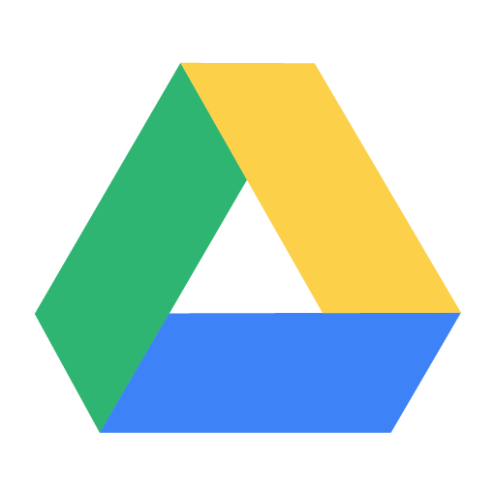


Abhishek Acharya
B.Tech Computer Science And Engineering
KIIT University
A project initiative by Aakar Software and Services
Mentor: Mr. Nilesh Shah
Notes:
No slide master

Slide 2
WELCOME!
Thank you for coming today!

Slide 3
Google Drive
Google Drive is a cloud storage service created by Google for millions of users to store and share their files.
Google Drive can reach millions of users due to extensive integration of Google and its services in today’s user life. Google Drive currently offers users 15GB free space on the cloud and has premium plans for expanding storage on a time basis.
Currently it has the maximum upload size for following:
Documents: Up to 1.02 million characters. If you convert a text document to Google Docs format, it can be up to 50 MB.
Spreadsheets: Up to 2 million cells for spreadsheets that are created in or converted to Google Sheets.
Presentations: Up to 100 MB for presentations converted to Google Slides.
All other files: Up to 5 TB.

Slide 4
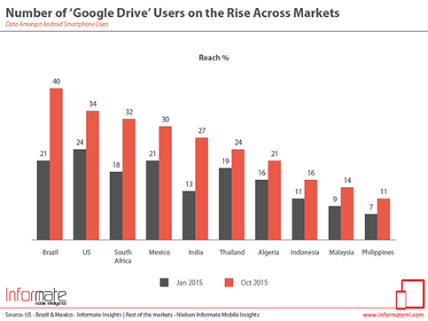

The reach of Google Drive across countries.

Slide 5
Google Drive
The core functionality of Drive apps is to download and upload files in Google Drive. However, the Drive platform provides a lot more than just storage. In this project I have focused on download and upload
The drive platform uses a model based on file IDs — rather than a traditional folder hierarchy — when working with Google Drive files and folders.

Slide 6
Google Drive Advantages and Disadvantages
Google Drive comes with an initial 15 gigabytes of storage, which is more than enough for the average user.
Others such as Onedrive offer only 5GB of free storage.
While most users will feel comfortable relying on Google to safely store their documents, not everyone feels at ease knowing that the company has access to their data. Google's business model is predicated on analyzing vast amounts of personal information and then selling it to advertisers.
Google Drive also allows you to control the level of access that you offer to shared documents. You can choose between 'can edit', 'can comment' and 'can view' settings.

Slide 7

Aim of this project
This project aims to make one understand how an API of a service such as Google Drive is implemented in one’s own service offering such as an app or a webpage.
This project can be integrated into future projects with ease to help users upload or download from their personal Google Drive.

Slide 8
SOME INFORMATION REGARDING THIS PROJECT.
The project aims specifically on download and upload of files to Google Drive. This project can be referenced or integrated by using the webpages created as frames.
index.html is the main page
CSS folder contains necessary CSS files for the webpage.
filepicker.js is the JavaScript file for integrating the Picker API. It can be directly used in further projects.
gdu folder contains files necessary for upload feature.
a.html is the webpage with upload capability having drop zone feature
progressbar.js and progressbar.min.js are two JavaScript files sourced (from https://kimmobrunfeldt.github.io/progressbar.js/) to integrate progress-bar feature to show that the files are being uploaded.
upload.js is the JS file for implementing necessary scopes and other things required for upload

Slide 9
Prerequisites for this project
To run this project on your computer, you'll need:
Python 2.4 or greater (to provide a web server).
On Windows start simple python server by running the following command in terminal opened in the project folder:
python -m http.server portNo
On Linux start simple python server by running the following command in terminal opened in the project folder:
python -m SimpleHTTPServer portNo
Access to the internet and a web browser.
A Google account with Google Drive enabled.
Project can be accessed on the web browser after starting the python server by typing the following address:
http://127.0.0.1:portNo

Slide 10

Prerequisite Setup for Google Drive APIs

Slide 11
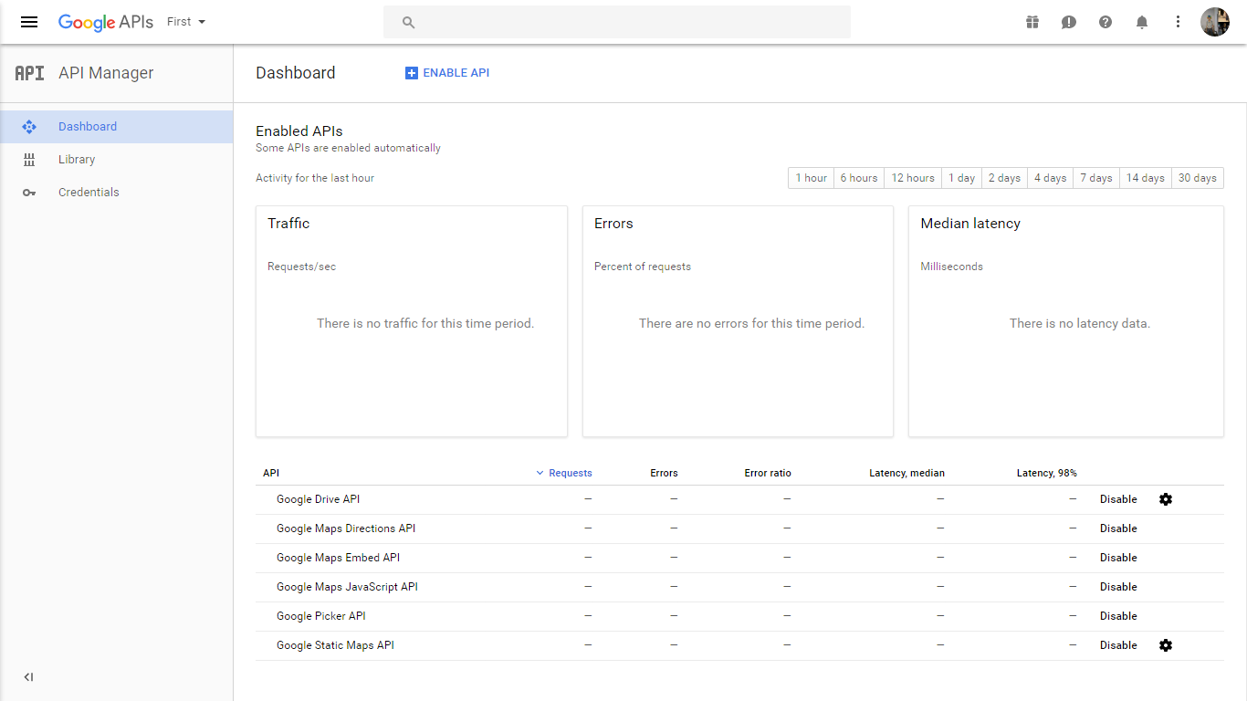
This is the Google API Console screen from where we can enable various API services of Google and create credentials.
We can access this page from:
https://console.developers.google.com/apis/dashboard

Slide 12
Step 1: Turn on the Drive API
Use this wizard to create or select a project in the Google Developers Console and automatically turn on the API. Click Continue, then Go to credentials.
On the Add credentials to your project page, click the Cancel button.
At the top of the page, select the OAuth consent screen tab. Select an Email address, enter a Product name if not already set, and click the Save button.
Select the Credentials tab, click the Create credentials button and select OAuth client ID.
Select the application type Web application.
In the Authorized JavaScript origins field, enter the URL http://localhost:8000. You can leave the Authorized redirect URIs field blank.
Click the Create button.
Take note of the client ID in the resulting dialog. You will need it in a later step.
Click OK to dismiss the resulting dialog.

Slide 13
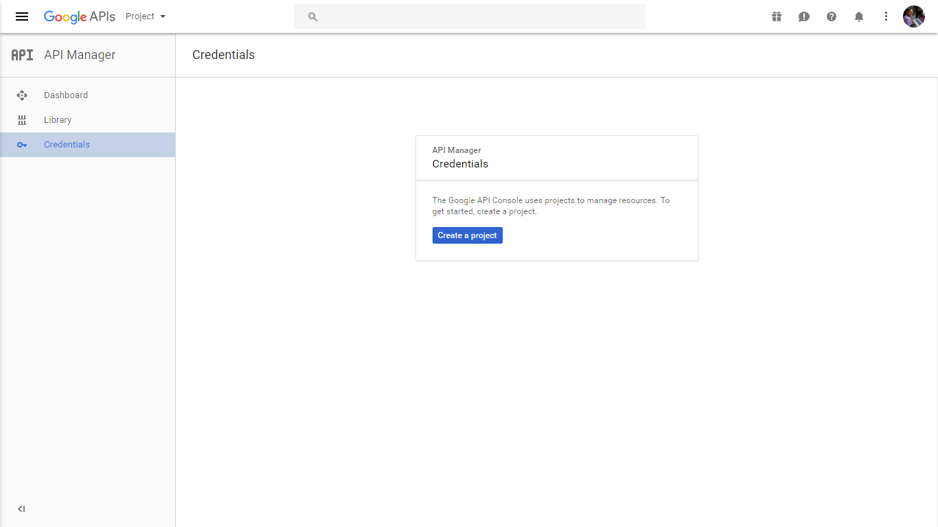
Click here to create project if you haven’t created one.

Slide 14
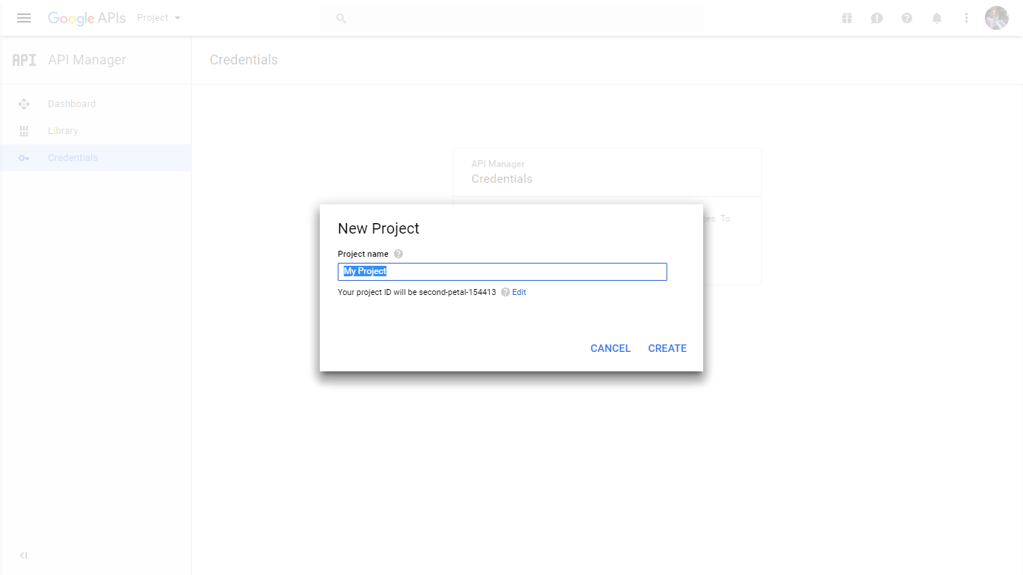
Write your desired name.
Click on create.

Slide 15
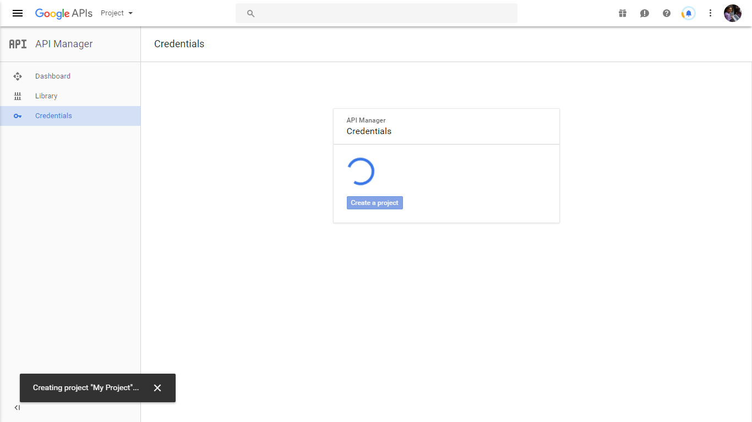
Project is being created.

Slide 16
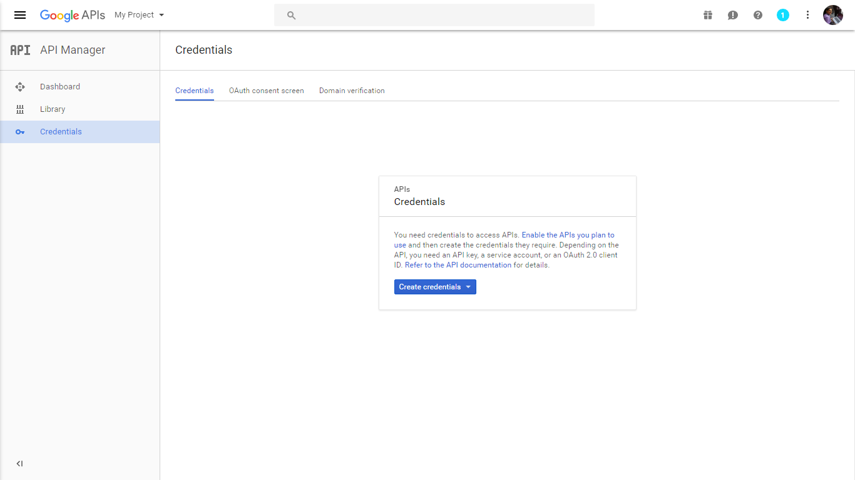
Click on Credentials.
Click on create credentials.

Slide 17
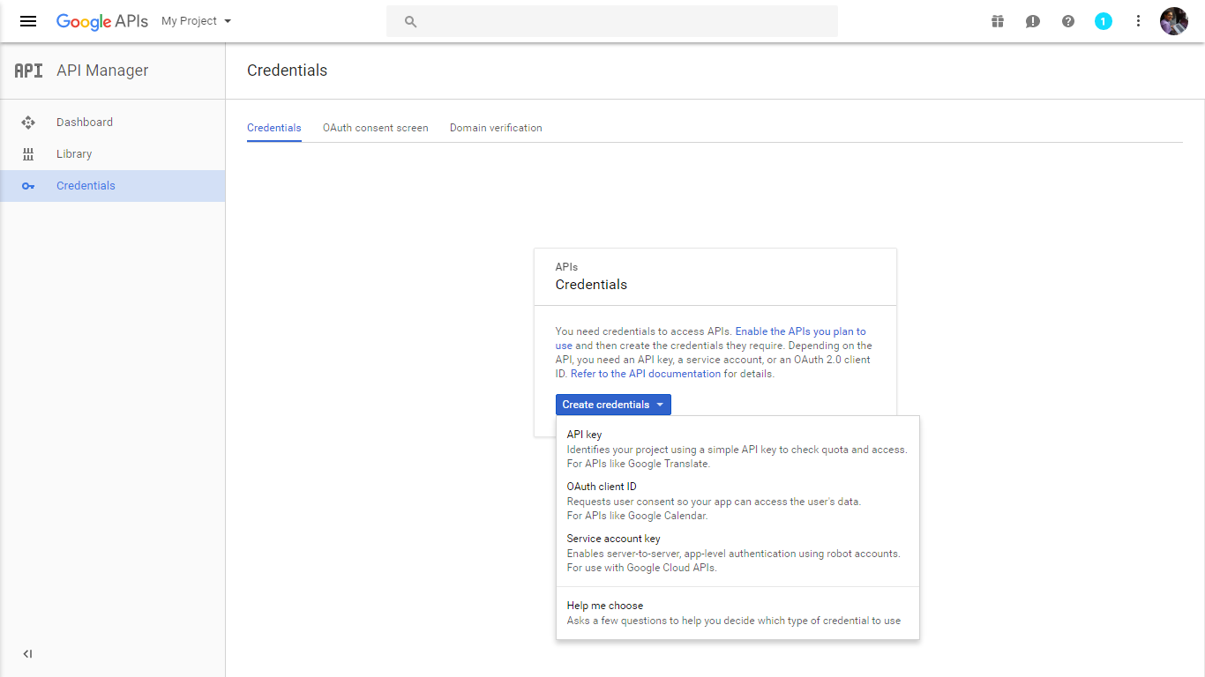
Click on create credentials and select OAuth client ID.

Slide 18
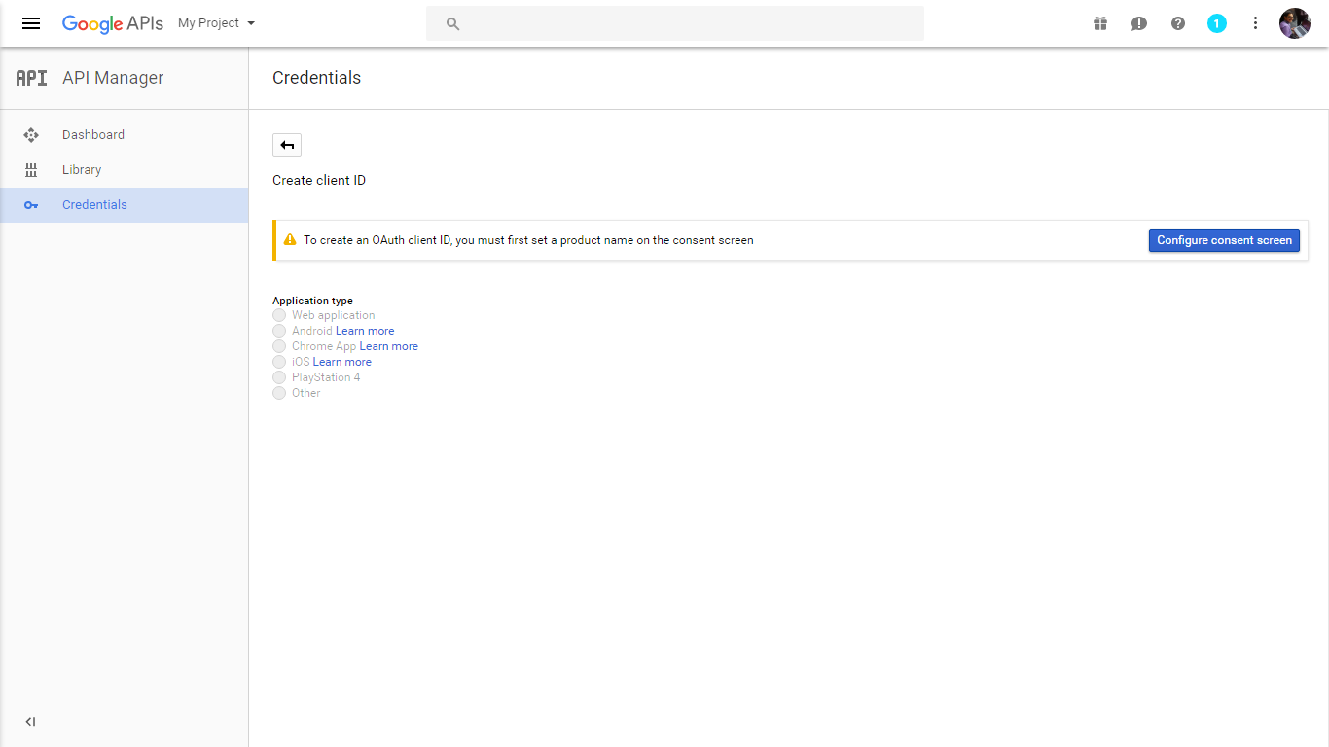
Click on configure consent screen to configure the icon and name of application shown on the permissions consent page.

Slide 19
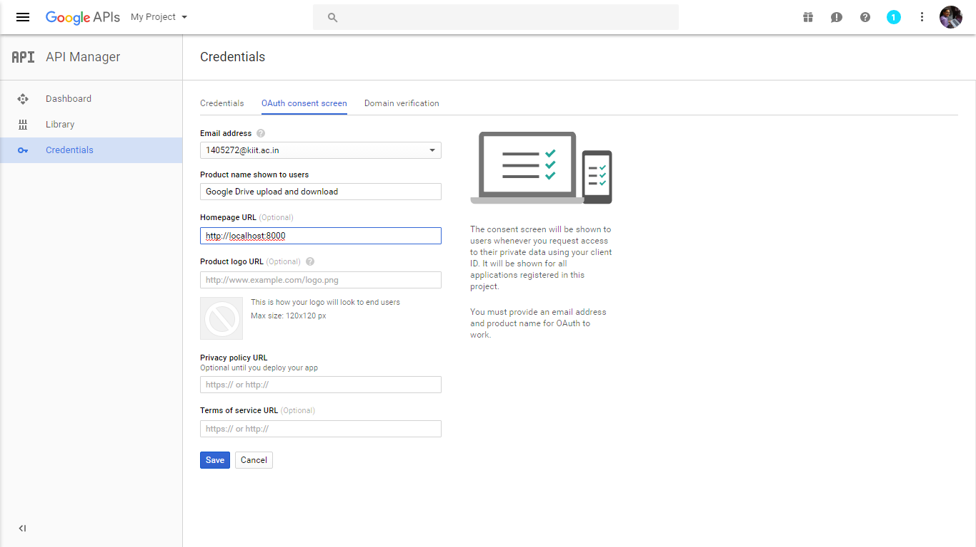
Enter the homepage URL which is localhost with port no. 8000, since we are hosting the page on locally created server.

Slide 20
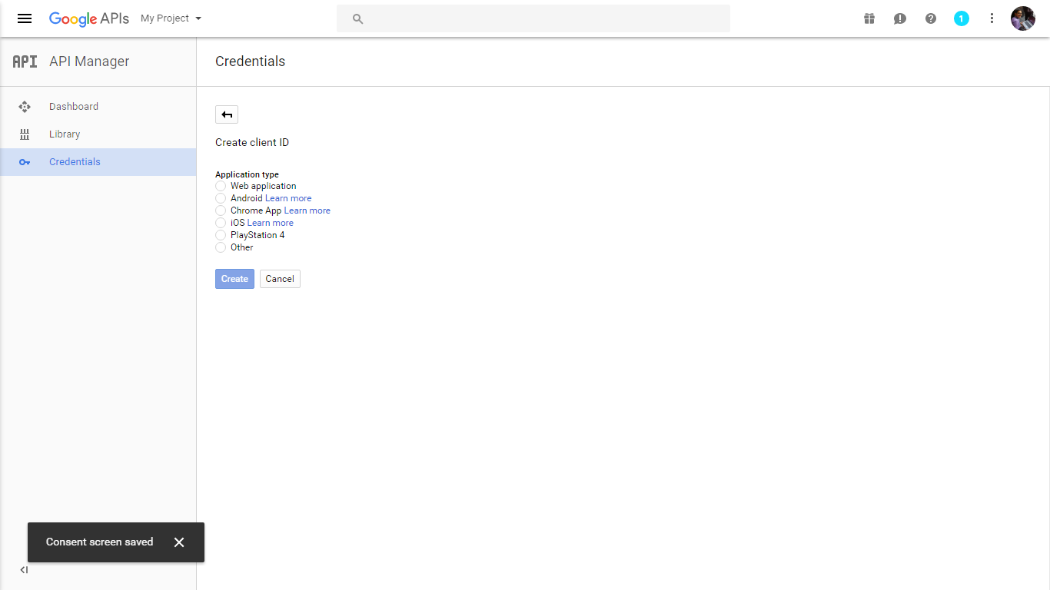
Click on Web application.

Slide 21
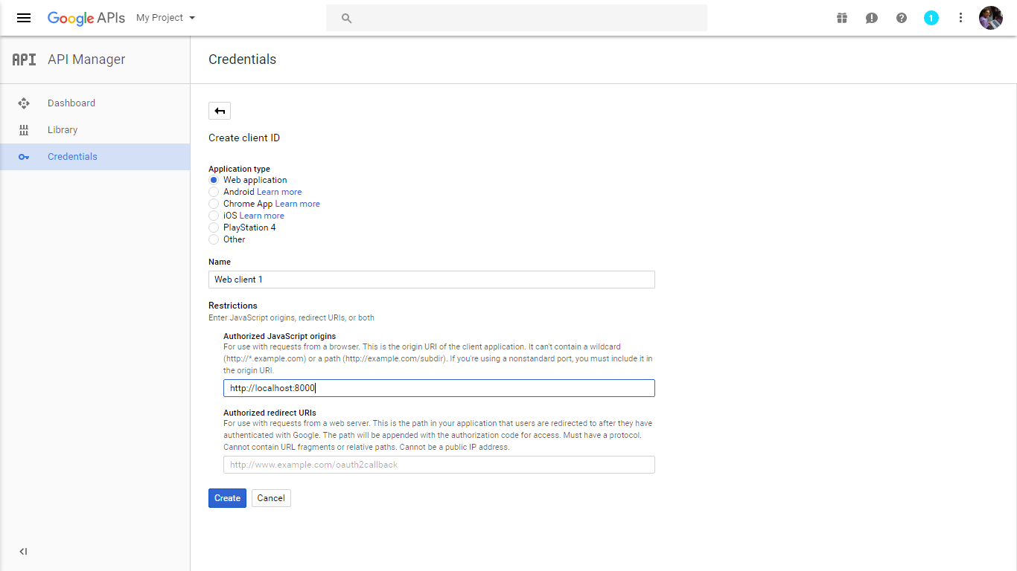
Enter the Name of the application.
Enter the webpage address where the JavaScript is embedded.
Click on create.

Slide 22
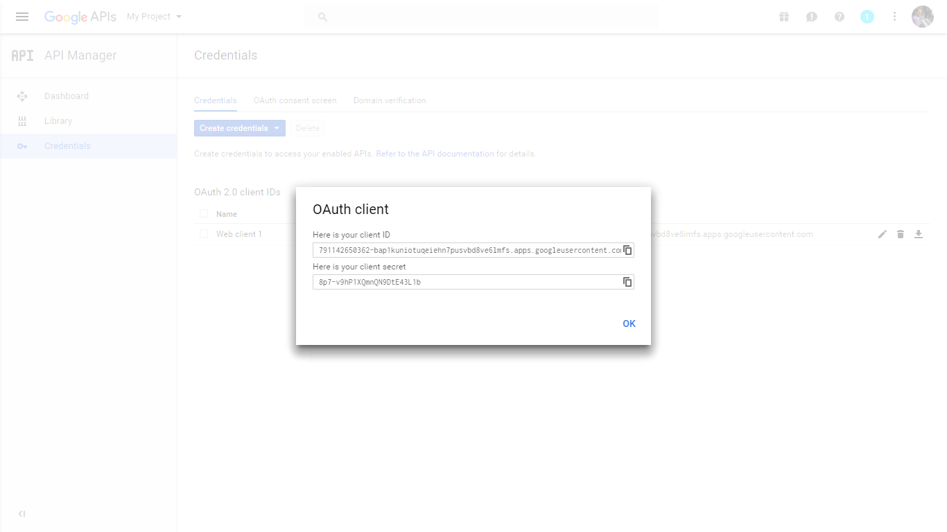
An OAuth Client credential is created. Copy this credential to use in the JavaScript source-code.

Slide 23
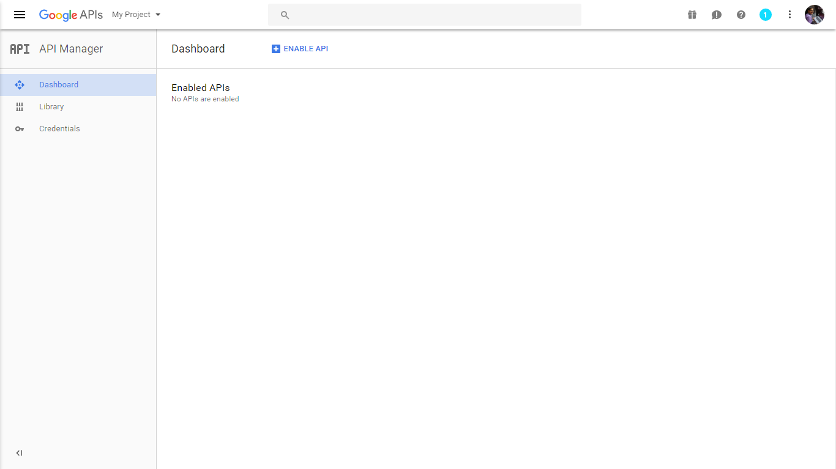
Click on Enable API to enable APIs.

Slide 24
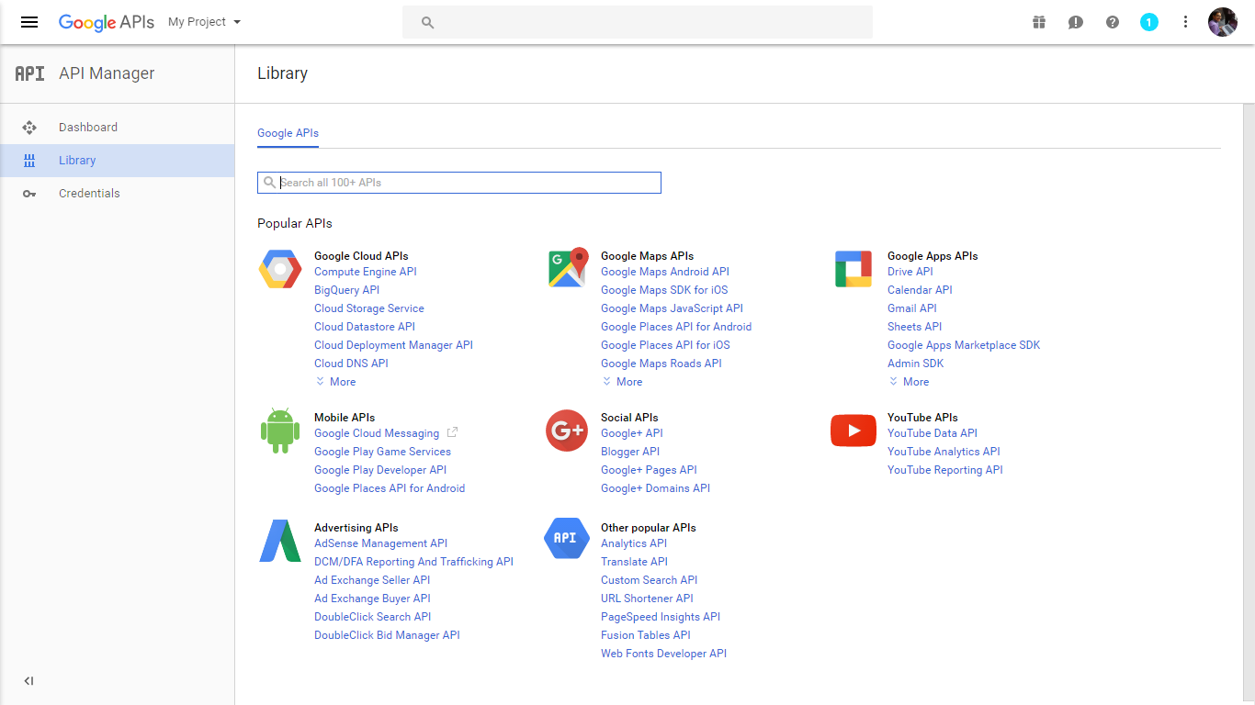
Click on Drive API to Enable Drive API.

Slide 25
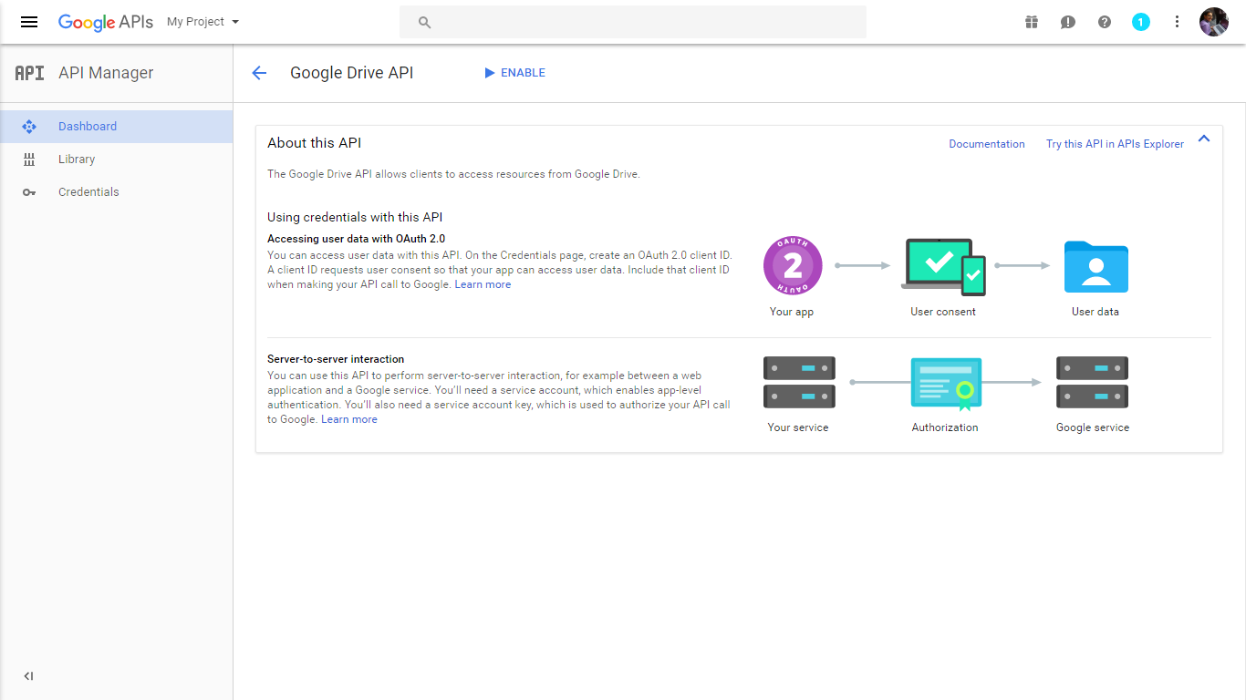
Click here to Enable the API.

Slide 26


Slide 27
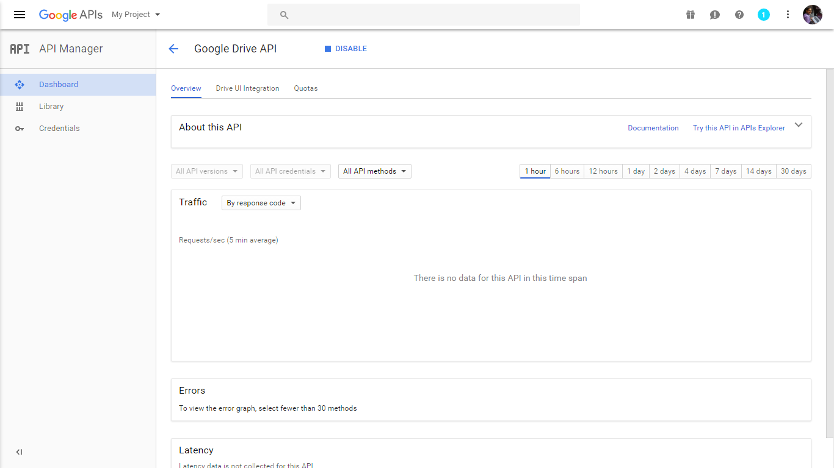
The Drive API is enabled . This shows the stats of usage and request made.

Slide 28
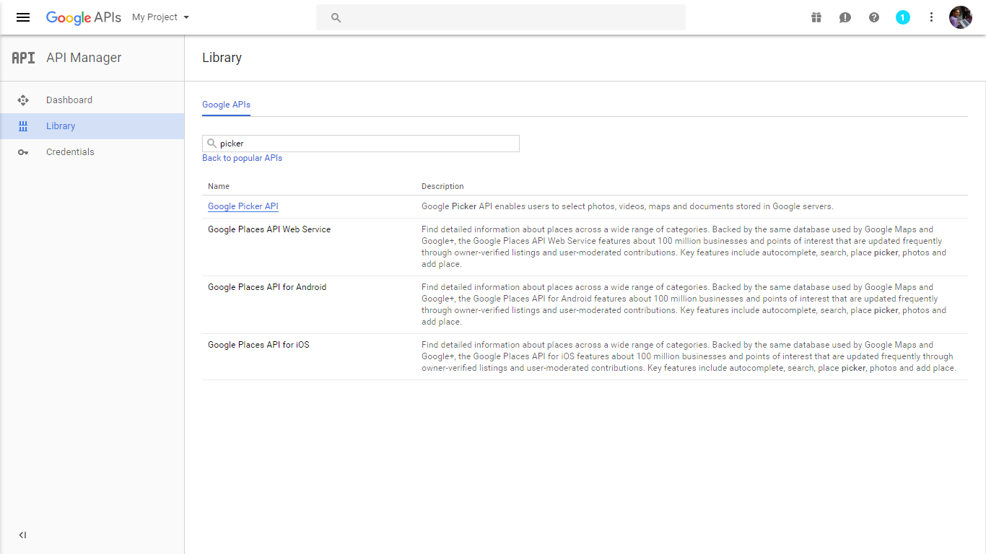
Search for Google Picker API to enable filepicker.

Slide 29
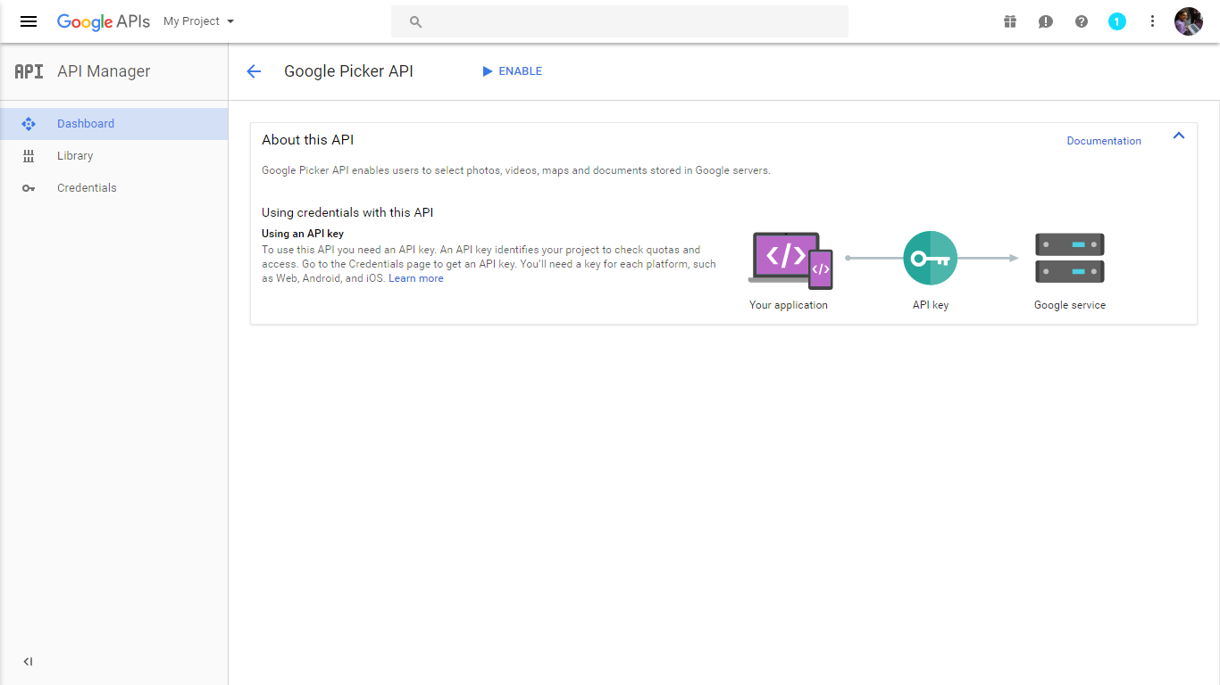
Similar to previous steps Enable this one too.

Slide 30
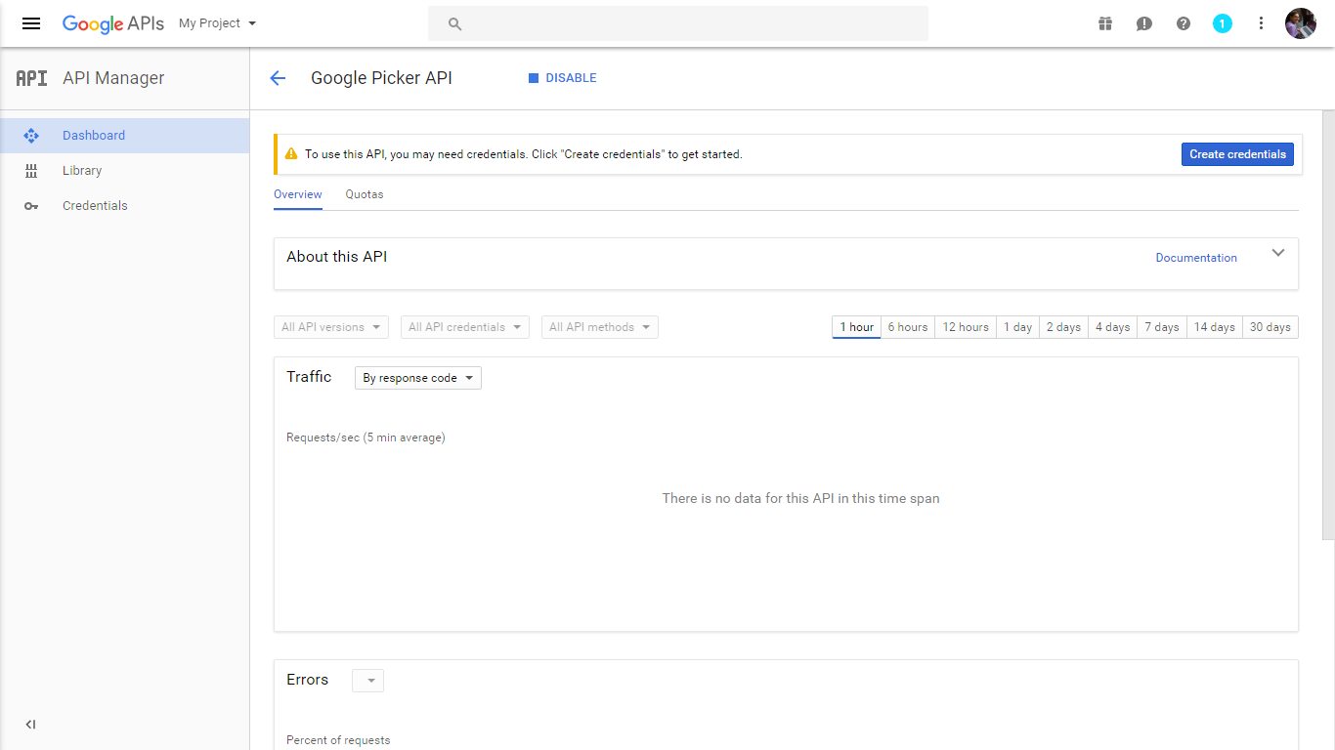
The Filepicker API is enabled . This shows the stats of usage and request made.

Slide 31
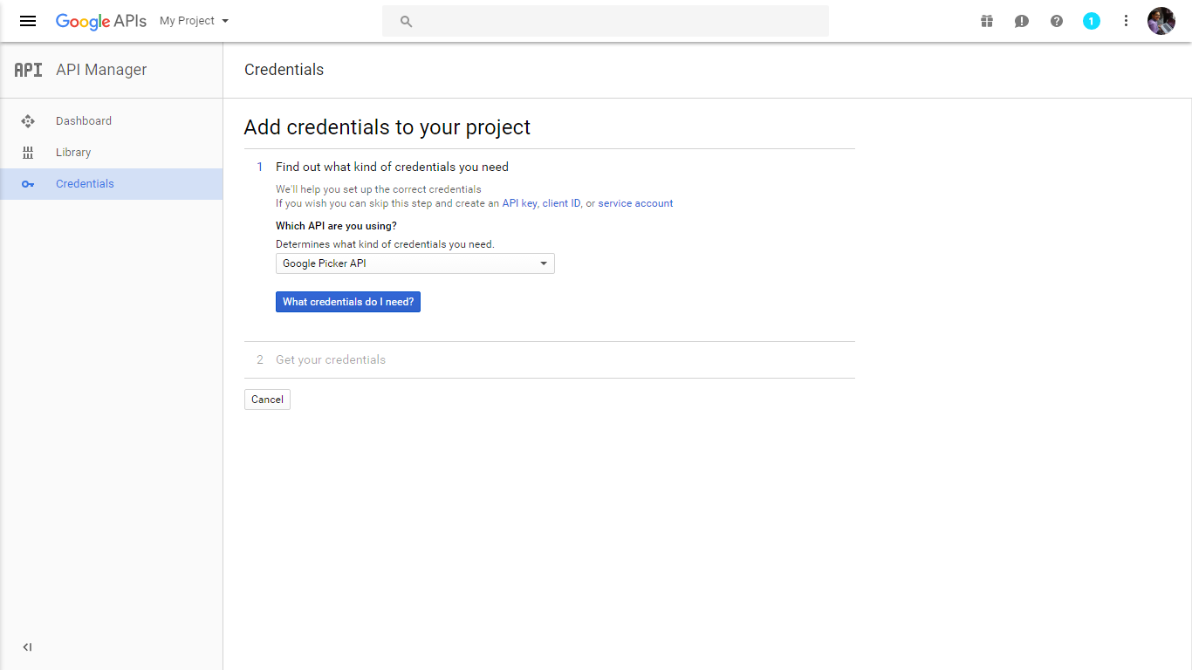
Go to Credentials
Select the API for which you want the API key, for us it is Picker API

Slide 32
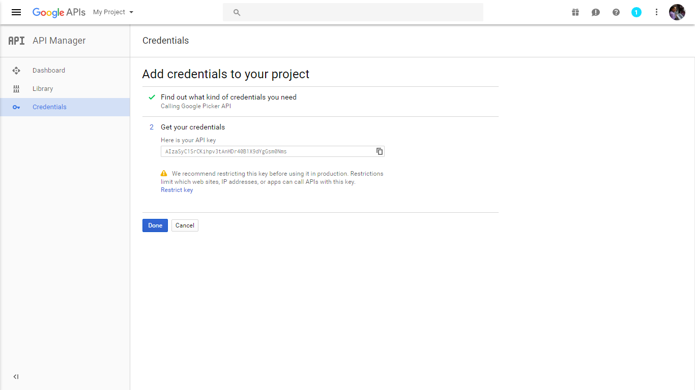
Copy this API Key generated to use for Filepicker JavaScript integrated into the page.

Slide 33
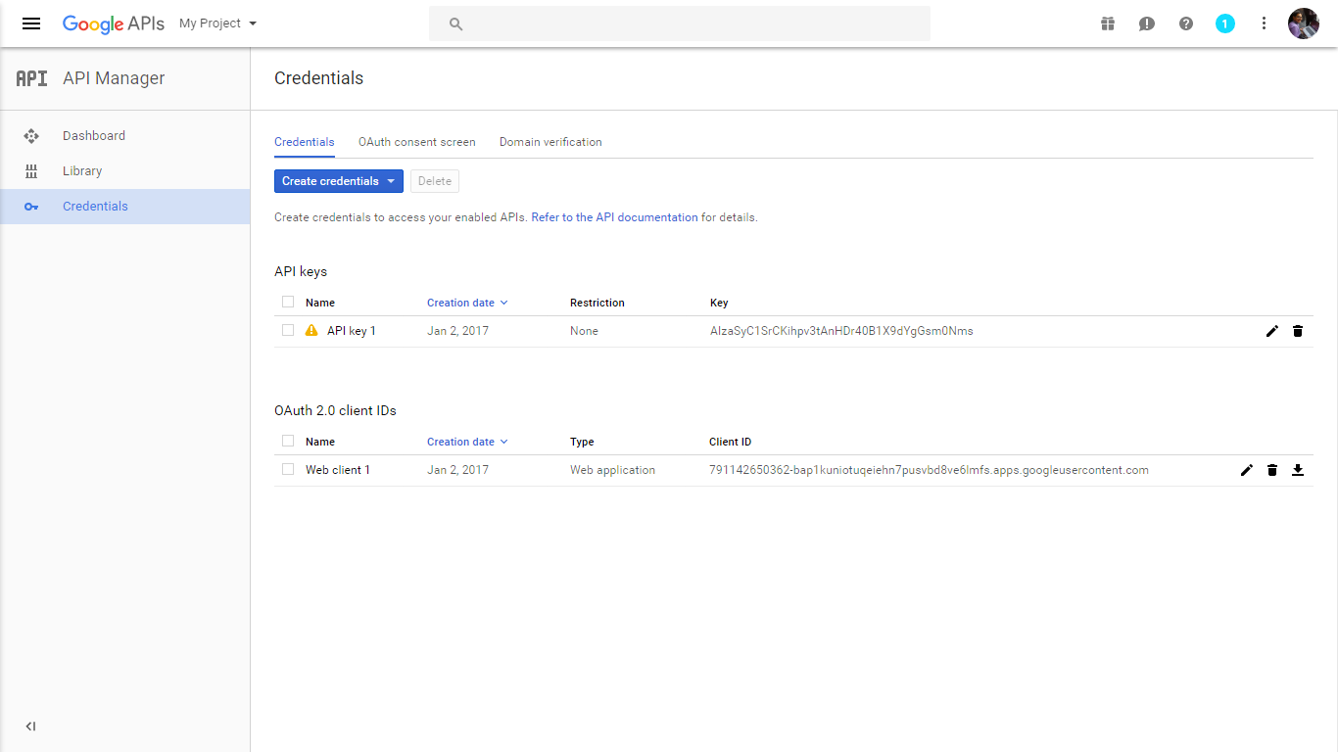
This Page shows the number of credentials we have created and we can
always access these to get our API key or OAuth details.

Slide 34
Step 2:
Start the Python server as mentioned in slide no 2
Run the JavaScript embedded html file.
The first time you run the sample, it will prompt you to authorize access for required permissions:
Click the Authorize button to open the authorization window.
If you are not already logged into your Google account, you will be prompted to log in. If you are logged into multiple Google accounts, you will be asked to select one account to use for the authorization.
Click the Accept button.
An Error can happen: origin_mismatch
This error will occur during the authorization flow if the host and port used to serve the web page doesn't match an allowed JavaScript origin on your Google Developers Console project.
Solution:
Make sure the URL mentioned in credential consent screen and that the URL in your browser matches.

Slide 35
The Project Demo

Slide 36
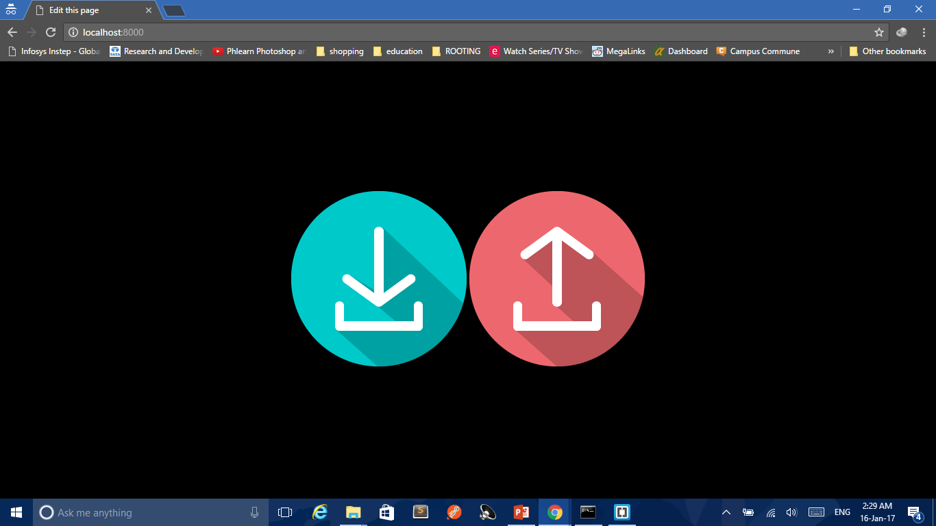
The blue download icon is for download through Filepicker.
And the red upload icon is for upload.

Slide 37
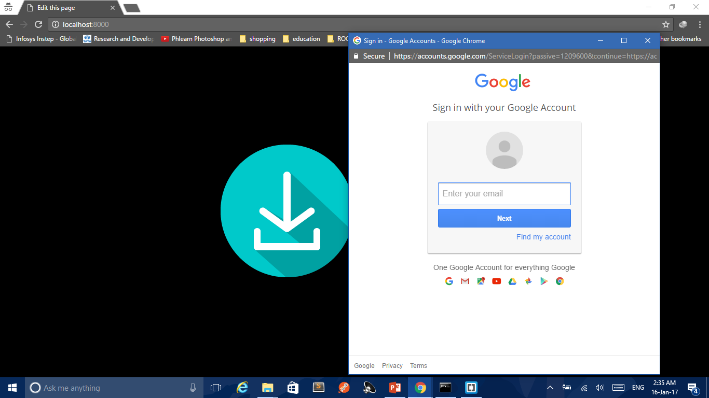
The login page opens to enter the email credential of the user.

Slide 38
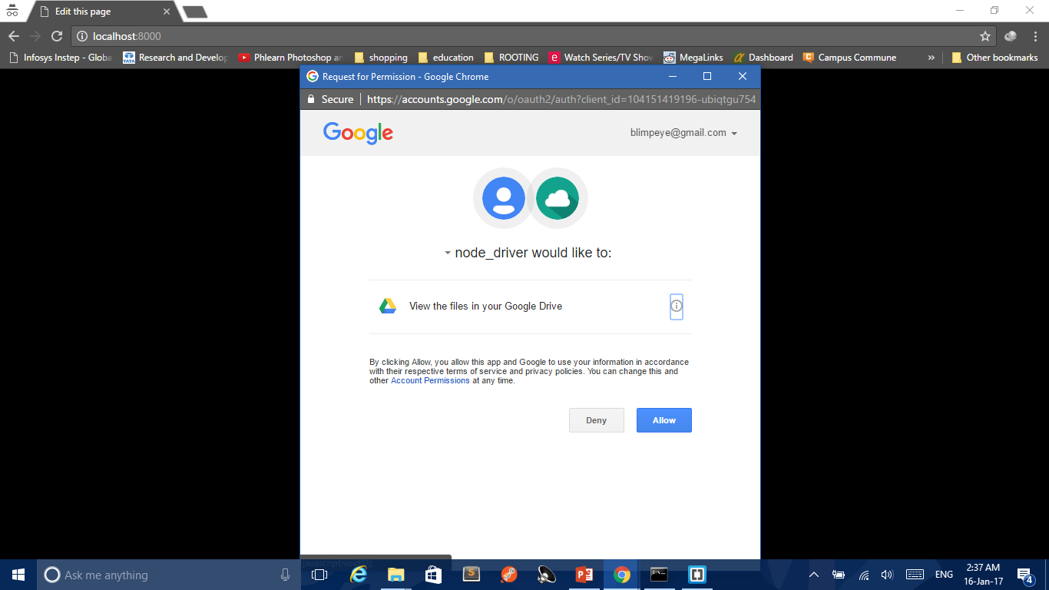
This is the permission required to access user’s Google Drive through filepicker.

Slide 39
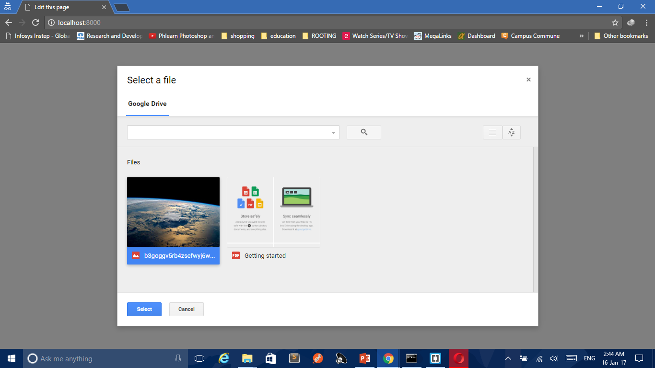
The frame for Filepicker window opens after confirmation of the permissions
User can select any file to open it or download it through new tab

Slide 40
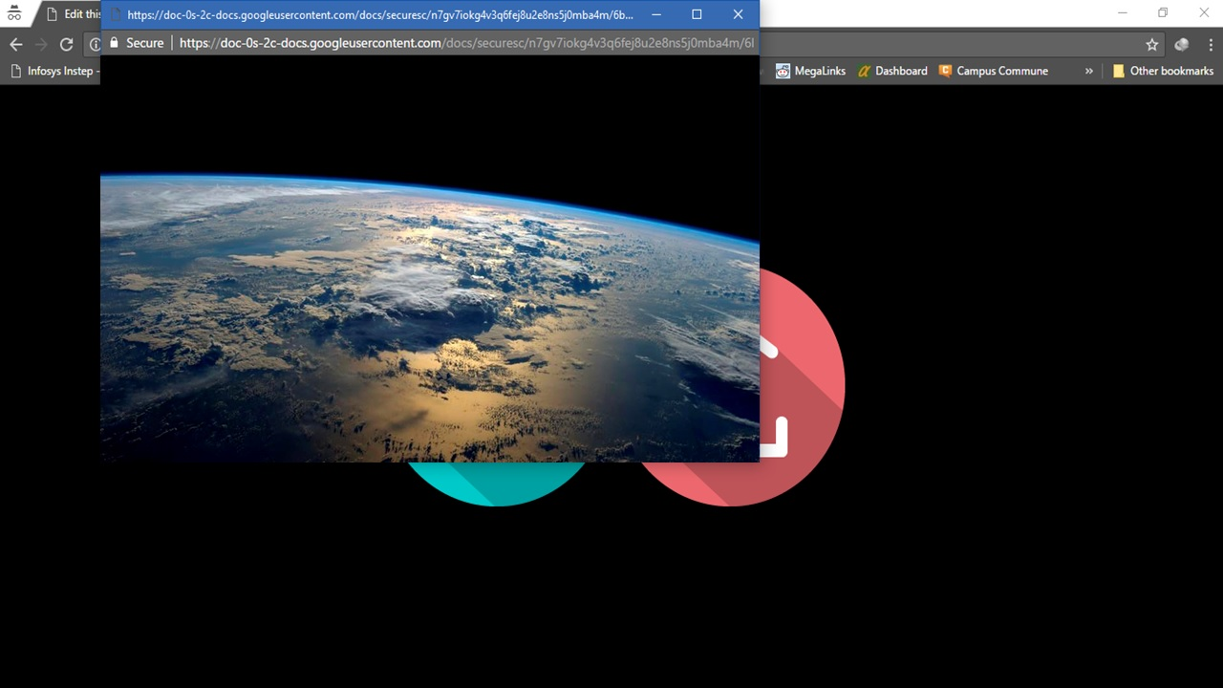

Slide 41
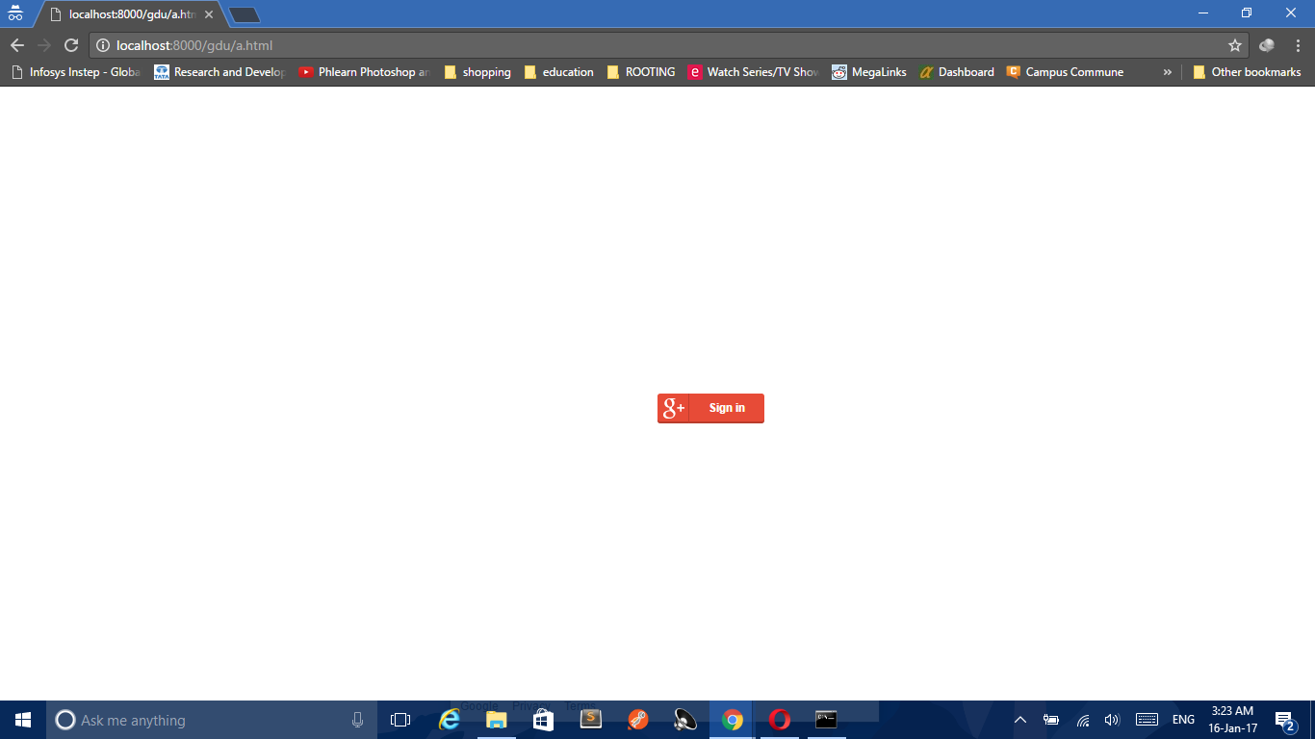
Click on sign-in logo to get signed in.

Slide 42
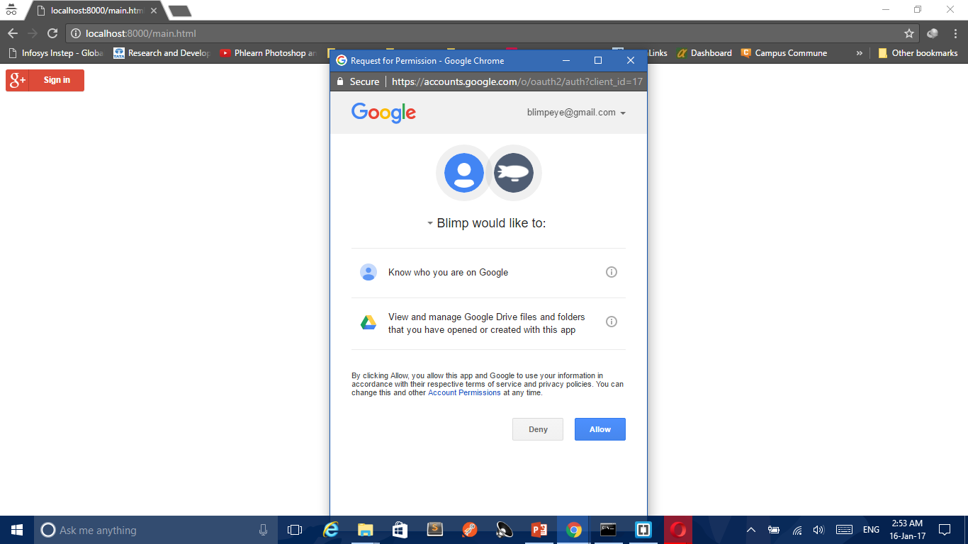
Permissions required for the upload.
The frame for allowing permissions opens.

Slide 43
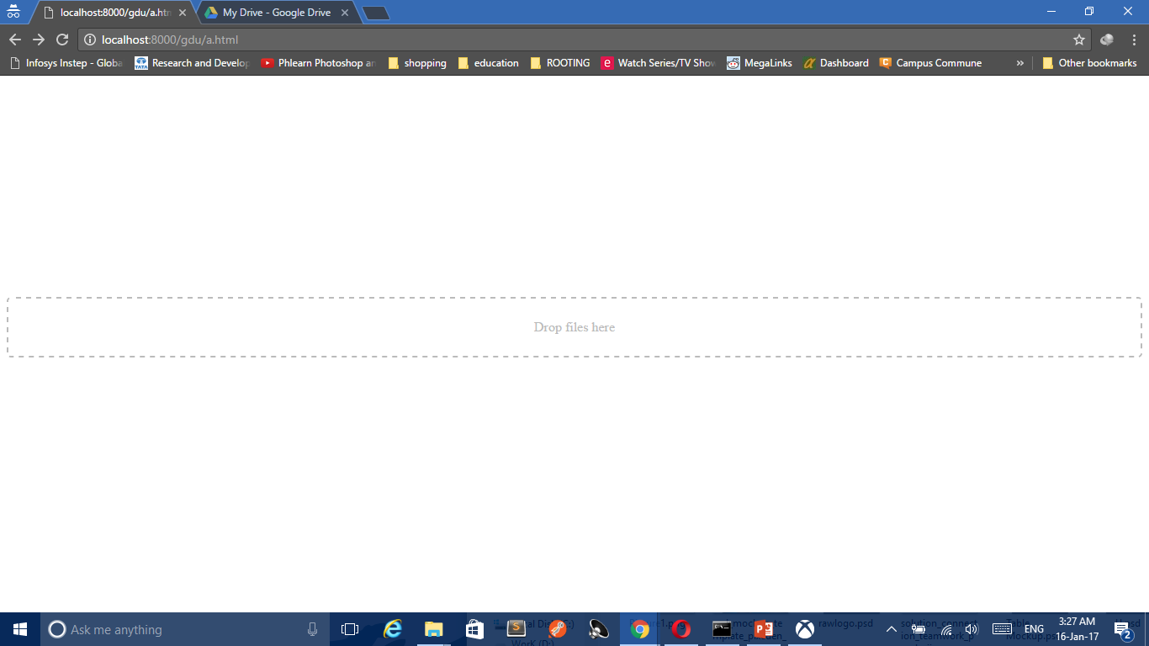
After allowing the permissions a drop zone opens. The user can drop file(s) here to
get their files uploaded to Google Drive

Slide 44
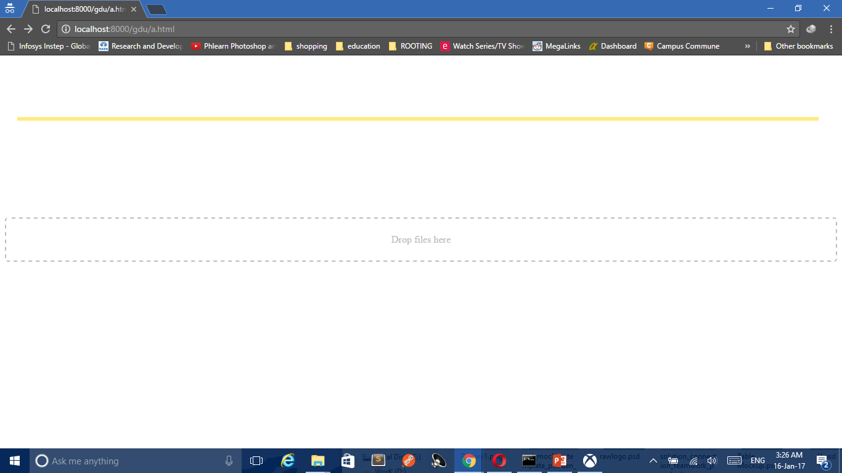
After dropping the files in the drop zone the progress-bar indicates
the uploading status of the file(s) dropped

Slide 45
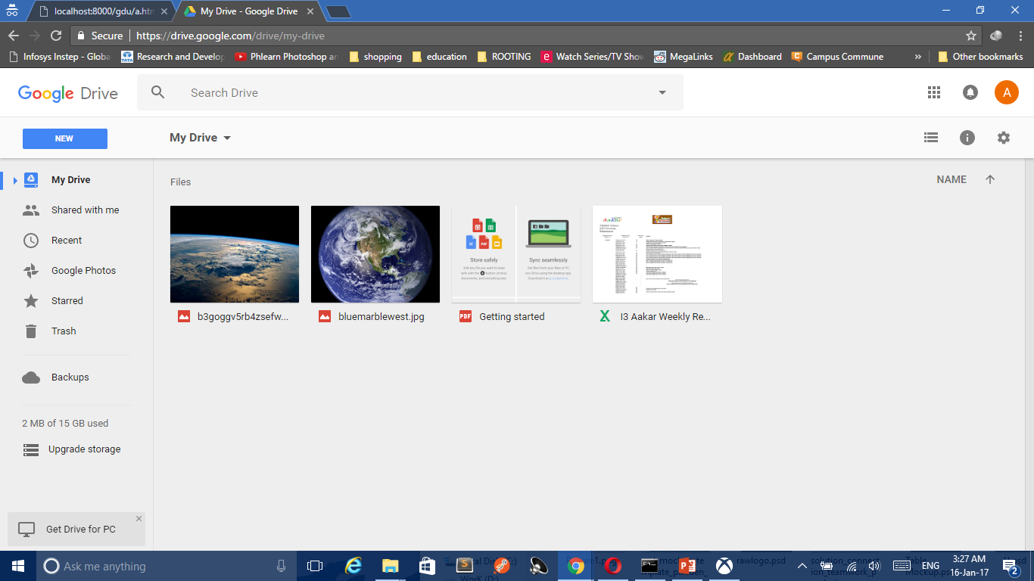
This was the file dropped to be uploaded and
has been uploaded successfully.

Slide 46
Why use Picker API to download from Google Drive?

Slide 47
Create and open files using the Google Picker
Drive files can be opened from an application independently of the Drive UI. An application can easily fetch and display a list of files with the Google Picker as described in Open files using the Google Picker.

Slide 48
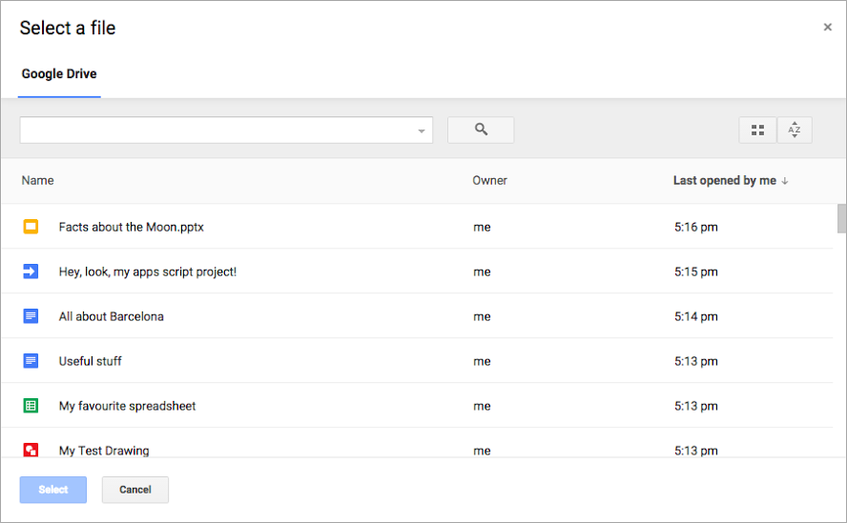
Google picker API
Google Picker is a "File Open" dialog for the information stored in Google servers. With Google Picker, your users can access and upload photos, videos, maps, and documents stored in Google servers. The selection is passed back to your web page or web application for further use.

Slide 49
Picker Class Reference
There is a list of classes, methods, and enumerated types available in the Google Picker API. They all belong to the namespace google.picker.*
There are two types of classes and enumerated types: those which are used to build and configure the Google Picker, and those which are returned by the Google Picker once the user has picked an item.
https://developers.google.com/picker/docs/reference#DocsView

Slide 50
Showing Different Views
We can use FilePicker to have a view of different types of files. We can do so by specifying through ViewId or by an instance of subclass google.picker.view
View Description | ViewId or Equivalent Class | OAuth Scope
All Google Drive items. | google.picker.​ViewId.DOCS or google. Picker.​DocsView | https://www.googleapis.com/auth/drive.readonly
Google Drive photos. | google.picker.​ViewId.DOCS_IMAGES | https://www.googleapis.com/auth/drive.readonly
Google Drive Documents. | google.picker.​ViewId.DOCUMENTS | https://www.googleapis.com/auth/drive.readonly
Google Drive Presentations. | google.picker.​ViewId.PRESENTATIONS | https://www.googleapis.com/auth/drive.readonly
Google Drive Spreadsheet. | google.picker.​ViewId.SPREADSHEETS | https://www.googleapis.com/auth/drive.readonly
Google Drive Forms. | google.picker.​ViewId.FORMS | https://www.googleapis.com/auth/drive.readonly
Google Drive photos and videos. | google.picker.​ViewId.DOCS_IMAGES_AND_VIDEOS | https://www.googleapis.com/auth/drive.readonly
Google Drive videos. | google.picker.​ViewId.DOCS_VIDEOS | https://www.googleapis.com/auth/drive.readonly
Google Drive Folders. | google.picker.​ViewId.FOLDERS | https://www.googleapis.com/auth/drive.readonly
Adobe PDF files stored in Google Drive. | google.picker.​ViewId.PDFS | https://www.googleapis.com/auth/drive.readonly

Slide 51
Different Permission Scopes
Scope | Meaning
https://www.googleapis.com/auth/drive | Full, permissive scope to access all of a user's files, excluding the Application Data folder. Request this scope only when it is strictly necessary.
https://www.googleapis.com/auth/drive.readonly | Allows read-only access to file metadata and file content
https://www.googleapis.com/auth/drive.appfolder | Allows access to the Application Data folder
https://www.googleapis.com/auth/drive.file | Per-file access to files created or opened by the app
https://www.googleapis.com/auth/drive.install | Special scope used to let users approve installation of an app.
https://www.googleapis.com/auth/drive.metadata | Allows read-write access to file metadata (excluding thumbnails), but does not allow any access to read, download, write, or upload file content. Does not support file creation, trashing, or deletion. Also does not allow changing folders or sharing in order to prevent access escalation.
https://www.googleapis.com/auth/drive.metadata.readonly | Allows read-only access to file metadata (excluding thumbnails), but does not allow any access to read or download file content.
https://www.googleapis.com/auth/drive.photos.readonly | Allows read-only access to all photos. The spaces parameter must be set to photos.
https://www.googleapis.com/auth/drive.scripts | Allows access to Apps Script files
As we saw for Picker API and Drive API used for download and upload have different permissions. Here is a summary of permission scopes we can use in the source-code for the application to ask for specific permission only.
These permissions are shown in the consent screen as we saw in the demo.

Slide 52
THANK YOU!
ANY QUESTIONS?

